Slide 1

Level: Advanced
Game Development with Unity
Omid Saadat

Slide 2
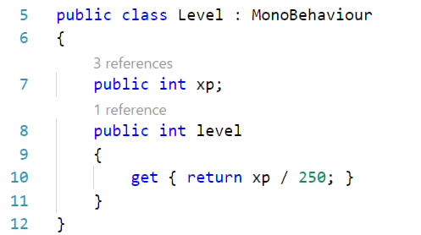

Custom Inspector
[CustomEditor(typeof(LookAtPoint))]

Slide 3
Usage
Display properties
Display Array/Lists
Customize display
Dropdown Buttons
Sorted lists
...

Slide 4
Important Notes:
Target, serializedObject
OnEnable? OnInspectorGUI?
DrawDefaultInspector
Best Practices in Documentation

Slide 5
Execute Scripts in EditMode
[ExecuteInEditMode]

